Slide 1
Midterm Exam Model Answer

Slide 2
Q 1.1
Discuss the benefit of both logical and physical independence in the relational model
Logical Data Independence: The capacity to change the conceptual schema without having to change the external schemas and their application programs.
This will enable: multiple views on the same database, and will make modification of both programs and DB much simpler
Physical Data Independence: The capacity to change the internal schema without having to change the conceptual schema.
Make developers focus less on physical implementation and focus more on DB design.
Makes DB design and development much simpler

Slide 3
Q 1.2
Discuss the different levels of a DBMS Schema
Internal schema at the internal level to describe physical storage structures and access paths. Typically uses a physical data model.
Conceptual schema at the conceptual level to describe the structure and constraints for the whole database for a community of users. Uses a conceptual or an implementation data model.
External schemas at the external level to describe the various user views. Usually uses the same data model as the conceptual level.

Slide 4
Q 2.1
Create 2 tables in a database as follows:
Department with attributes: Dep_id, name, Bldng, phone_num
Employee with attributes: Emp_id, name, Address, Depid
Choose the appropriate data types for the attributes. Please note that these 2 tables have a 1-to-many relationship

Slide 5
Q 2.1
CREATE TABLE department
( name VARCHAR(15),
Dep_id INT NOT NULL,
bldng VARCHAR(2),
phone_num INT,
PRIMARY KEY (dep_id) );
CREATE TABLE employee
(Emp_id INT NOT NULL,
name VARCHAR(15),
address VARCHAR(10),
depid INT,
PRIMARY KEY (Emp_id),
FOREIGN KEY (depid) REFERENCES DEPARTMENT(dep_id)
On delete cascade on update cascade );

Slide 6
Q 2.2
Add a new employee with the following data: <001, Mohamed Ahmed, Heliopolis, 002>.
Insert into employee values (001, ‘Mohamed Ahmed’, ‘Heliopolis’, 002);

Slide 7
Q 2.3
Change the Address of employee with name ‘Samir Ibrahim’ to ‘Nasr City’.
Update employee
Set address = ‘Nasr City’
Where name =’Samir Ibrahim’;

Slide 8
Q 2.3
Remove the record for the department whose name is ‘IS’ and propose the necessary changes in the related tables.
Delete
From department
Where name = ‘IS’
The related employees (whose dep is IS will be deleted as well)

Slide 9
Q 3
Based on the below database schema, write the following Select statements
Book: (Book_ID, title, pub_id, author_ID)
Author: (Author_ID, name, city, phone_num)
Publisher: (Pub_id, name, city, phone_num)
The schema is assuming that each book has only one author and one publisher while the author and publisher produce many books. (a book has 1-to-many relationship with both author and publisher).

Slide 10
Q 3.1
List all book titles that starts with “Information”.
Select title
From Book
Where title like ‘Information%’;

Slide 11
Q 3.2
List all publisher names count and city grouped by their city and the city should have at least 2 publishers.
SELECT city, count(*)
FROM Publisher
GROUP BY city
HAVING Count(*)>=2
(this question is cancelled)

Slide 12
Q 3.3
List book title, author name, and publisher name sorted by book title
Select title, author.name, publisher.name
From author, publisher, book
Where Book.pub_id=Publisher.Pub_id and book.author_ID=Author.Author_ID
Order by title

Slide 13
Q 3.4
List all publisher names who do not have books in the database.
SELECT distinct Publisher.name
From Publisher
Where Publisher.name not in (
select Publisher.name
from Publisher, book
where book.pub_id = Publisher.Pub_id);

Slide 14
Q 3.4 ( Another Solution)
Select publisher.name
From publisher left join book on Publisher.Pub_id=Book.pub_id
Where Book.Pub_id is NULL

Slide 15
Q 4
Construct an E-R diagram for a car-insurance company:
The company keeps track of customers and insured cars. In addition, it stores information about accidents.
Each Customer has an id (Cus_id), a name (Cus_name), a derived attribute (age) and address in terms of city, street_name, and zipcode. The customer may register with more than one address.

Slide 16
Q 4
Each car has the following attributes; a license no, a model, a year and multiple colors.
Each accident has the following attributes; report_id (unique within each car), date and address in terms of city, street_name, and zipcode.
Each customer may have zero or multiple cars.

Slide 17
Q 4
However, each car is owned by one and only one customer. You should track which customers own one or more cars.
Each car has associated with it zero to any number of recorded accidents

Slide 18
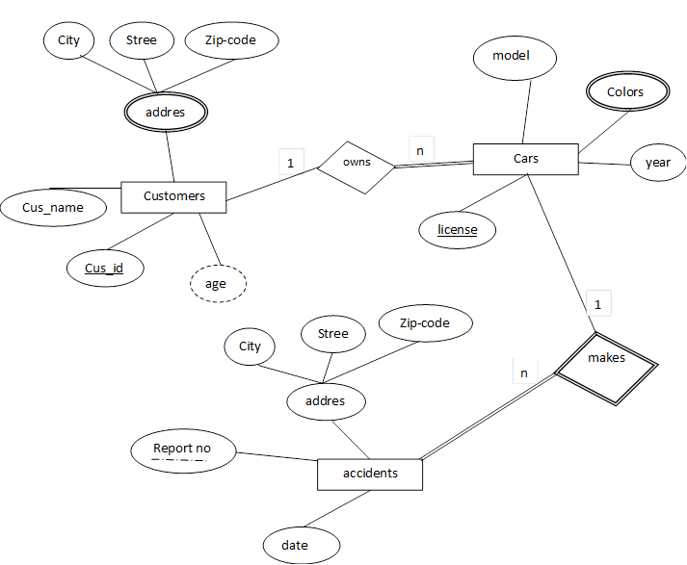
Q 4

Slide 19
Nested Queries Examples
List the names of all employees in the same departments as ‘Smith’ or ‘Jones’
Select EmpName
From Employee
Where EmpDepartmentID IN
(Select E.EmpDepartmentID From Employee E
Where EmpName = 'Jones' or EmpName = 'Smith')

Slide 20
Nested Queries Examples
List all Details of the employees who are NOT managed by the manager of ‘Jones’
Select EmpName
From Employee
Where EmpMangerID NOT IN
(Select E.EmpMangerID
From Employee E
Where EmpName = 'Jones')

Slide 21
Nested Queries Examples
list the names of all employees with a salary higher than the average employee salary
Select EmpName
From Employee
Where EmpSalary >
(Select avg (EmpSalary)
From Employee)

Slide 22
Join Example
list the names of all the employees and the names of their managers.
Select E. EmpName as 'Employee Name', M.EmpName as 'Manager Name'
From Employee as E inner join Employee as M
on E.EmpManagerID = M.EmployeeID

